Slide 1

Quarterly marketing meeting
NORTHWIND TRADERS
6 December 2024

Slide 2
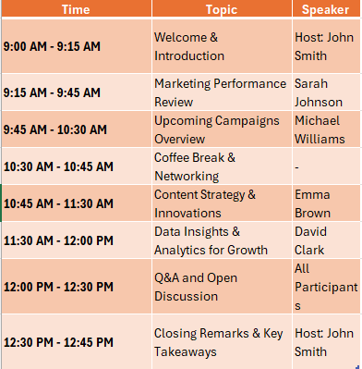
Important Events

Slide 3
Current market analysis
Data reveals a steady increase in consumer demand for sustainable products, presenting an opportunity for our co-friendly offerings.
Our competitors are now focusing on digital marketing strategies, suggesting a shift in consumer behavior.
Understanding these nuanced dynamics positions us to adapt and capitalize on emerging market preferences.

Slide 4
Product launch timeline
Product development
User testing
Product launch
Q2
Q1
Q4
Q3
Market research
Currently gearing up for a ground-breaking launch
Our new offerings will captivate the market
Our marketing campaign will generate anticipation

Slide 5
Thank you
Peyton Davis | 424-555-0124
peyton@northwindtraders.com
www.northwindtraders.com

